Slide 1
All-optical wavelength conversion
11/8/2018
University of Southern California
Team 558 - Optical Fiber Communication Systems
Prof. Willner
Presented by Binh Phan

Slide 2
Motivation
Tunable Wavelength Converter (TWC)
λ₁
λ₂
All-optical: no electronics – too slow and costly
Applications: packet switching, contention resolution

Slide 3
Outline
1. Semiconductor Optical Amplifier (SOA)
2. AOWC using cross-gain modulation (XGM) in SOA
3. AOWC using cross-phase modulation (XPM) in SOA
4. AOWC using four-wave mixing (FWM) in SOA
5. Performance Comparison

Slide 4
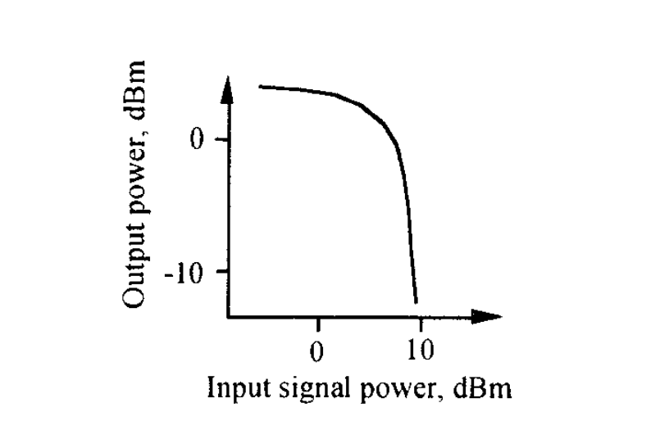
Semiconductor Optical Amplifier (SOA)
Stubkjær, K., Jørgensen, C., Danielsen, S. L., Mikkelsen, B., Vaa, M., Pedersen, R. J. S., ... Ratovelomanana, F. (1996). Wavelength conversion devices and techniques. In Proceedings of the 22nd European Conference on Optical Communication (Vol. Volume 4, pp. 33-40). IEEE.

Slide 5
Semiconductor Optical Amplifier (SOA)
High input signal power -> No gain
Stubkjær, K., Jørgensen, C., Danielsen, S. L., Mikkelsen, B., Vaa, M., Pedersen, R. J. S., ... Ratovelomanana, F. (1996). Wavelength conversion devices and techniques. In Proceedings of the 22nd European Conference on Optical Communication (Vol. Volume 4, pp. 33-40). IEEE.

Slide 6
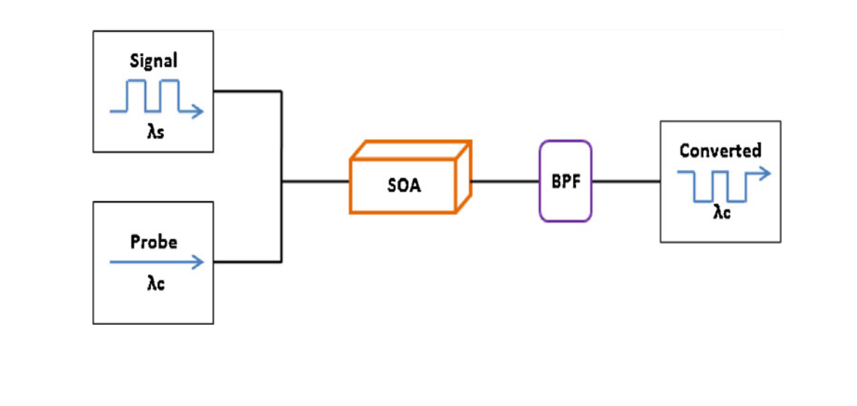
AOWC using cross-gain modulation (XGM) in SOA
Farah Diana Mahad,Abu Sahmah M.Supa’at. “Comparative performance testing of SOA wavelength conversion techniques for future all-optical systems,” International Journal for Light and Electron Optics (Optik), April 2012.

Slide 7
AOWC using cross-gain modulation (XGM) in SOA
λ_{s} HIGH: Deplete carriers in SOA -> no gain -> λ_{c} * small value
Farah Diana Mahad,Abu Sahmah M.Supa’at. “Comparative performance testing of SOA wavelength conversion techniques for future all-optical systems,” International Journal for Light and Electron Optics (Optik), April 2012.

Slide 8
AOWC using cross-gain modulation (XGM) in SOA
λ_{s} HIGH: Deplete carriers in SOA -> no gain -> λ_{c} * small value
Inverted signal
Farah Diana Mahad,Abu Sahmah M.Supa’at. “Comparative performance testing of SOA wavelength conversion techniques for future all-optical systems,” International Journal for Light and Electron Optics (Optik), April 2012.

Slide 9
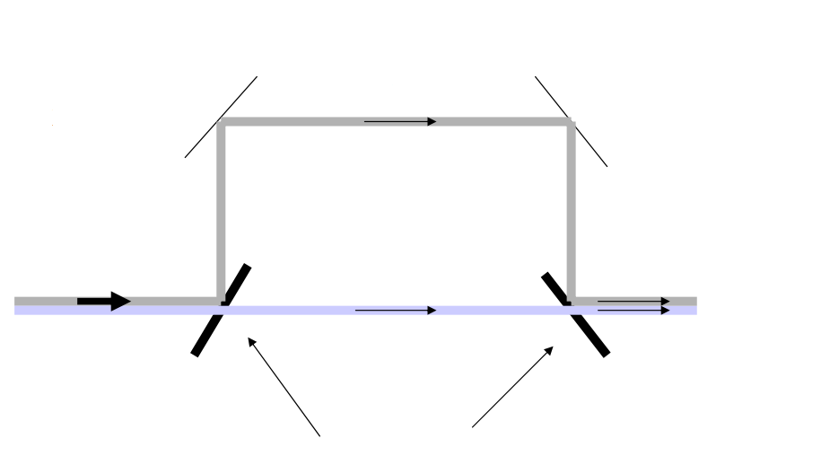
AOWC using cross-phase modulation (XPM) in SOA
Mach-Zender Interferometer
Converts phase modulation to intensity modulation

Slide 10
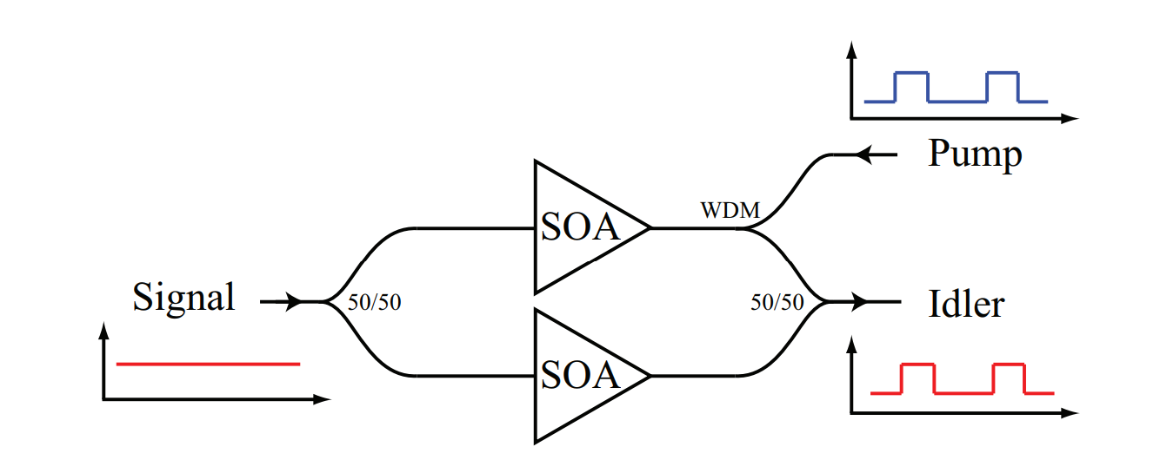
AOWC using cross-phase modulation (XPM) in SOA
Provo, Richard (2010). Nonlinear Techniques for Optical Wavelength Conversion (Doctoral dissertation). Retrieved from The University of Auckland

Slide 11
AOWC using cross-phase modulation (XPM) in SOA
λ_{Pump} HIGH: Deplete carriers in SOA -> Δn -> Δф
Provo, Richard (2010). Nonlinear Techniques for Optical Wavelength Conversion (Doctoral dissertation). Retrieved from The University of Auckland

Slide 12
AOWC using cross-phase modulation (XPM) in SOA
λ_{Pump} HIGH: Deplete carriers in SOA -> Δn -> Δф
MZI: Δф -> ΔI
Provo, Richard (2010). Nonlinear Techniques for Optical Wavelength Conversion (Doctoral dissertation). Retrieved from The University of Auckland

Slide 13
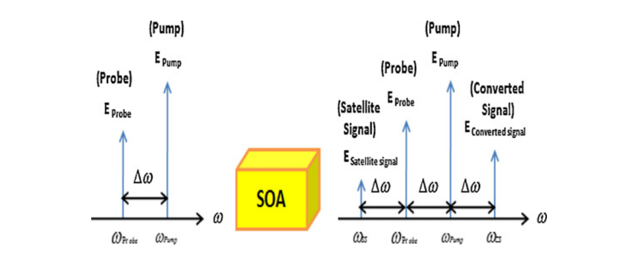
AOWC using four-wave mixing (FWM) in SOA
Farah Diana Mahad,Abu Sahmah M.Supa’at. “Comparative performance testing of SOA wavelength conversion techniques for future all-optical systems,” International Journal for Light and Electron Optics (Optik), April 2012.

Slide 14
AOWC using four-wave mixing (FWM) in SOA
Farah Diana Mahad,Abu Sahmah M.Supa’at. “Comparative performance testing of SOA wavelength conversion techniques for future all-optical systems,” International Journal for Light and Electron Optics (Optik), April 2012.

Slide 15
Performance Comparison
 | Supports 10 Gb/s | Supports PSK and other modulation formats
XGM | Yes | No
XPM | Yes | No
FWM | Yes | Yes
Each have their pros and cons.

Slide 16
Summary
AOWC is essential for packet switching and contention resolution
XGM, XPM, FWM
Fast, supports 10 Gb/s
XGM and XPM only support ASK, FWM can support PSK and other modulation formats

Slide 17
Thank you!

